Slide 1
Installation Guide
DDM4351
EA: Smart Home Experience Project (Group Project) Group 3
By LAU Ka Pui

Slide 2
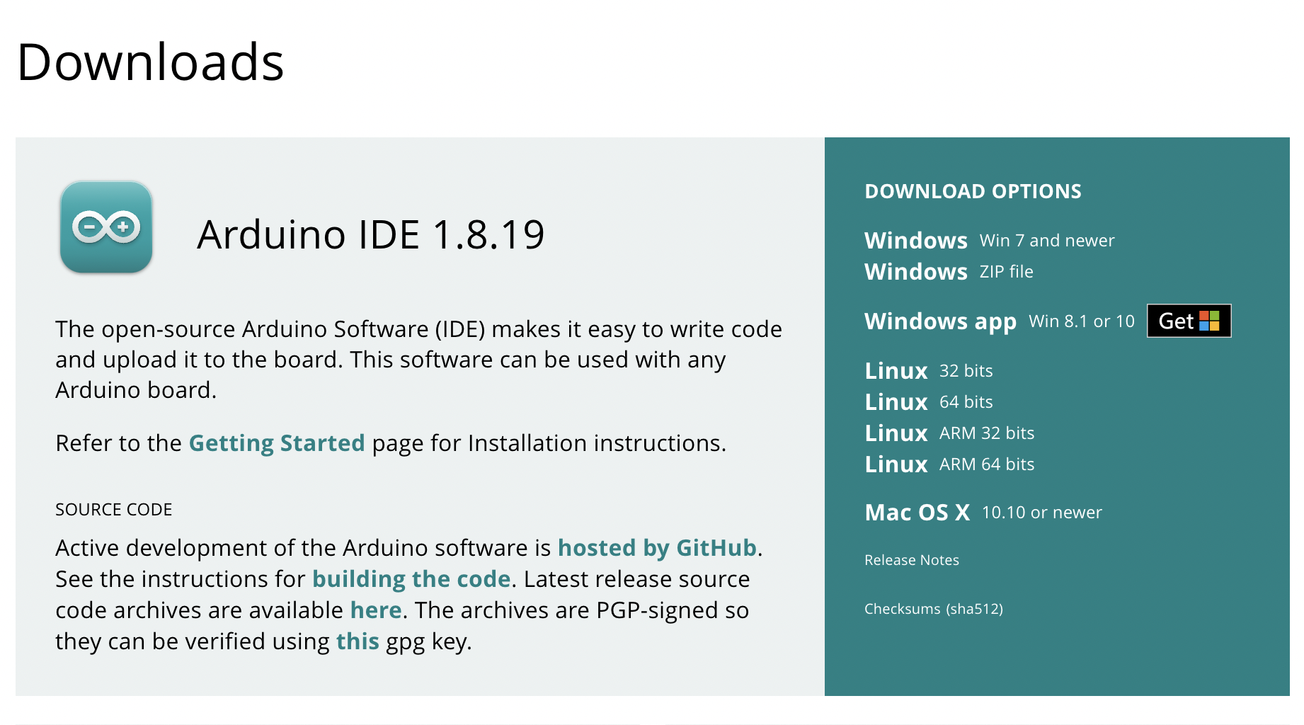
Download and install Arduino to your computer
https://www.arduino.cc/en/software

Slide 3
Configure your NodeMCU ESP32 motherboard according to the schematic

Slide 4
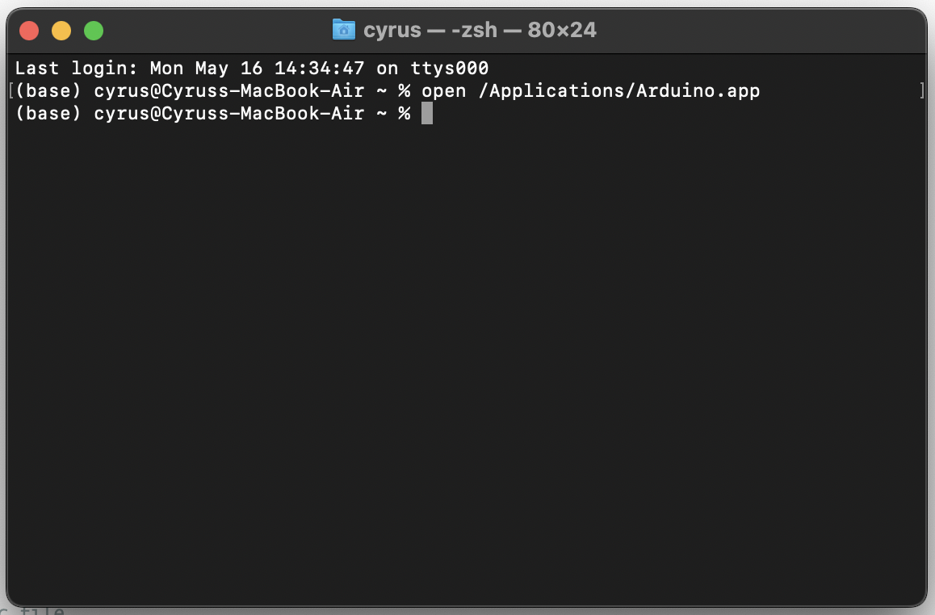
Open Arduino by Terminal if you are using Mac computer with Apple Silicon (M1 Chip…)
*The following problems can be solved if you open Arduino by Terminal:
Multiple found: …/WiFiServer.h
"python": executable file not found in $PATH on M1
https://stackoverflow.com/questions/71638410/python-executable-file-not-found-in-path-on-m1

Slide 5
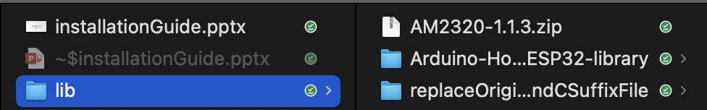
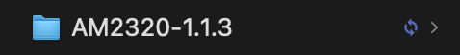
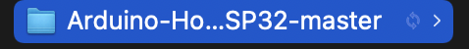
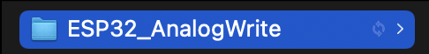
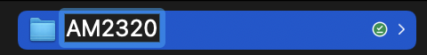
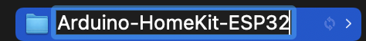
Open the “lib” folder and unzip the main items

Slide 6
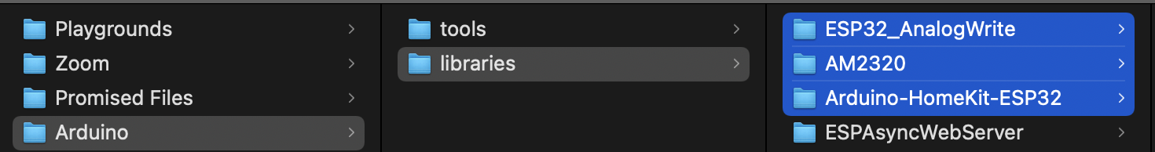
Put the previously unzipped libraries into the Arduino/libraries folder on your computer
*If you already have an "ESP32_AnalogWrite" folder, just replace the original folder with the new .h and .c files and delete all the .cpp files with same name in it

Slide 7
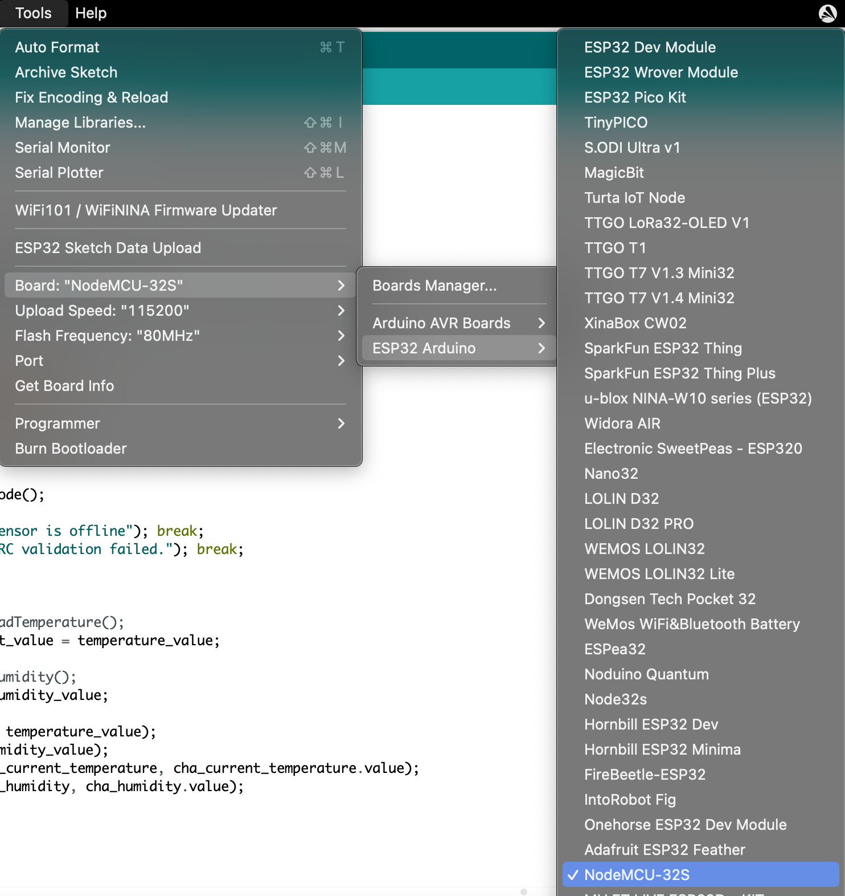
You must select a NodeMCU-32s board and use the correct port on your Arduino application

Slide 8
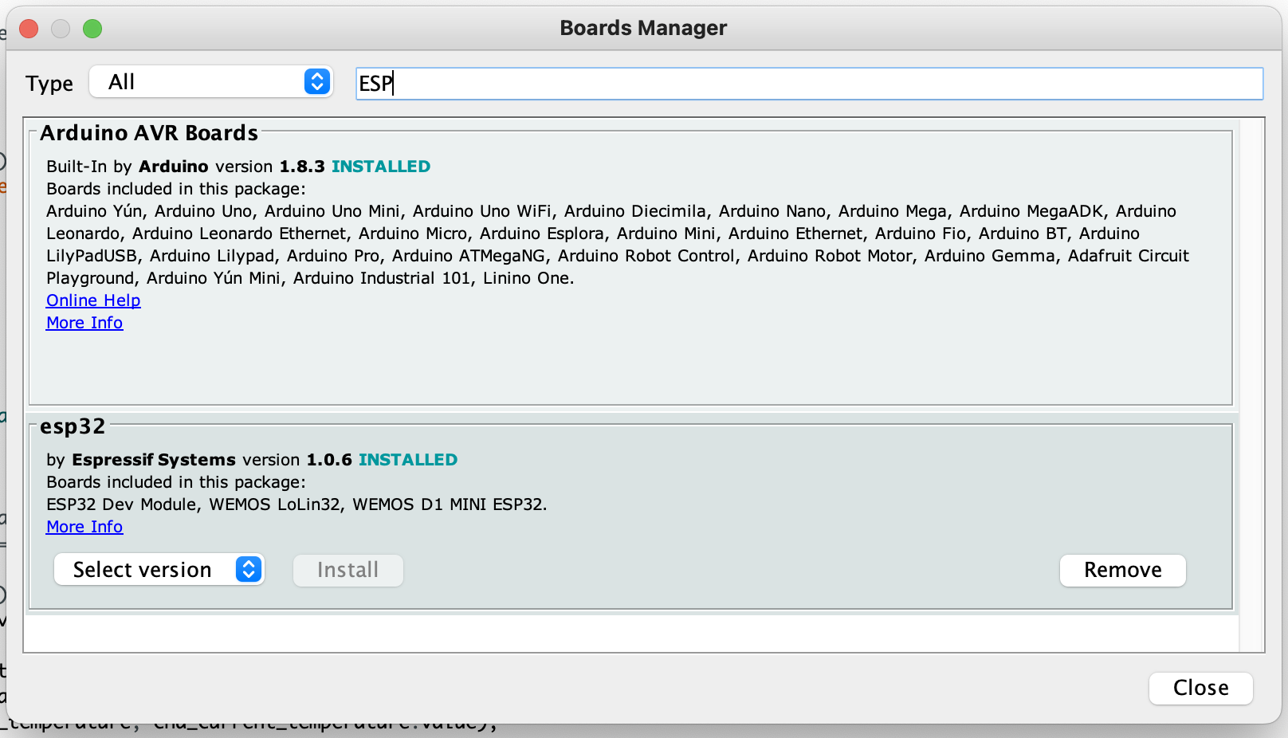
If you don't have a NodeMCU-32s board in your "Board", you should enter this URL into the Arduino "Preferences", you can now find the board in the "Boards Manager"

Slide 9
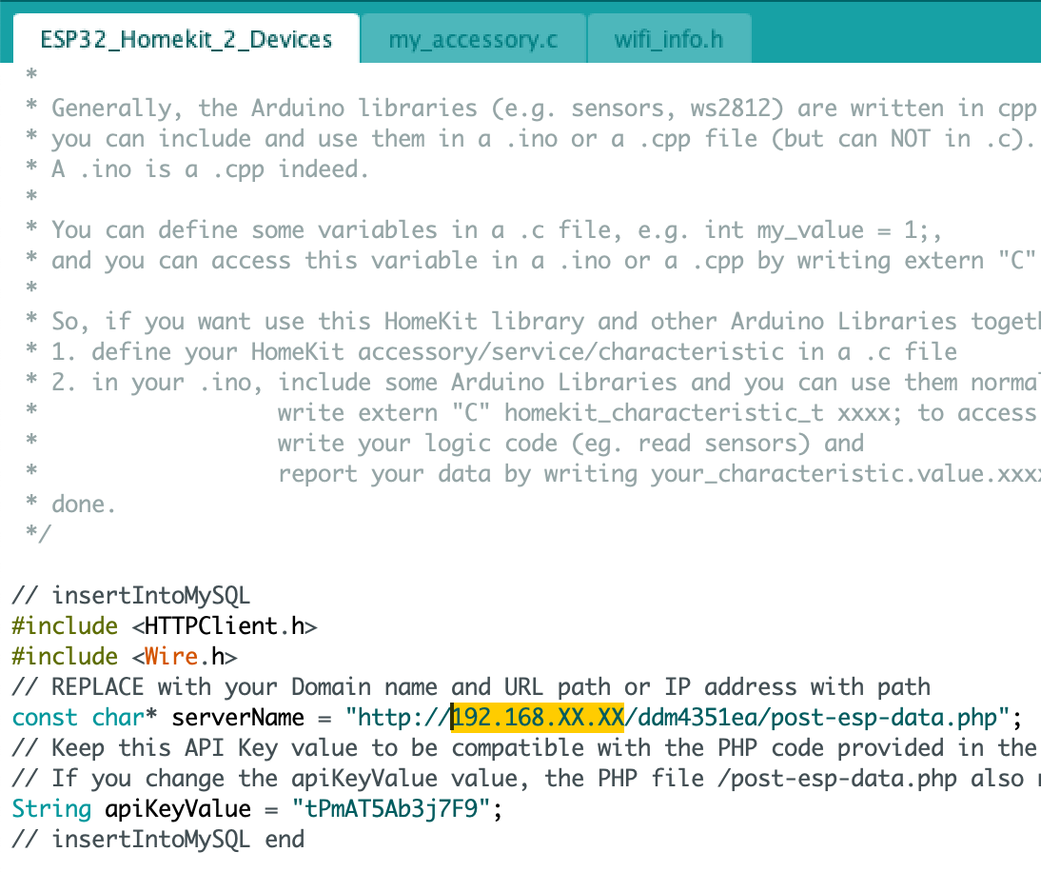
Modify 192.168.XX.XX to your WiFi IP address

Slide 10
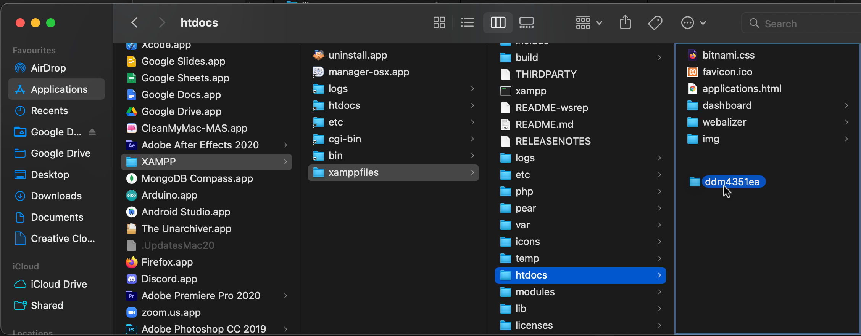
Put the ddm4351ea folder into your XAMPP htdocs folder

Slide 11
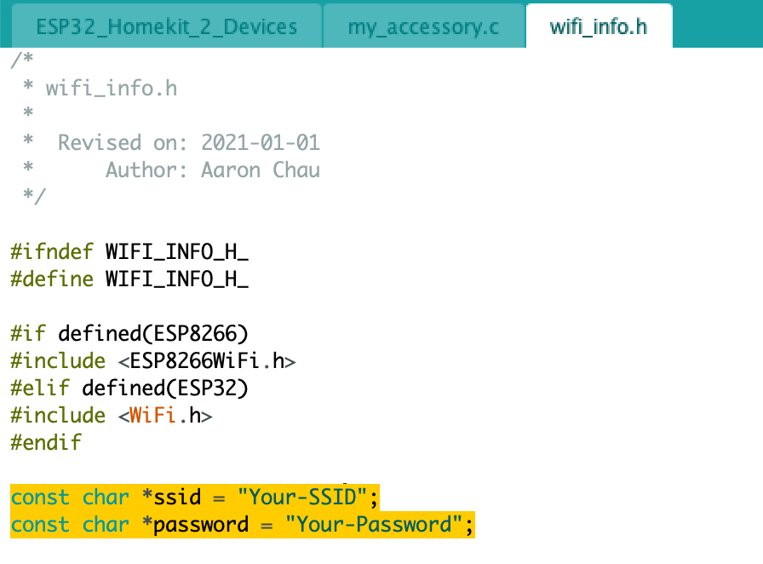
Configure your WiFi username and password in the main program

Slide 12
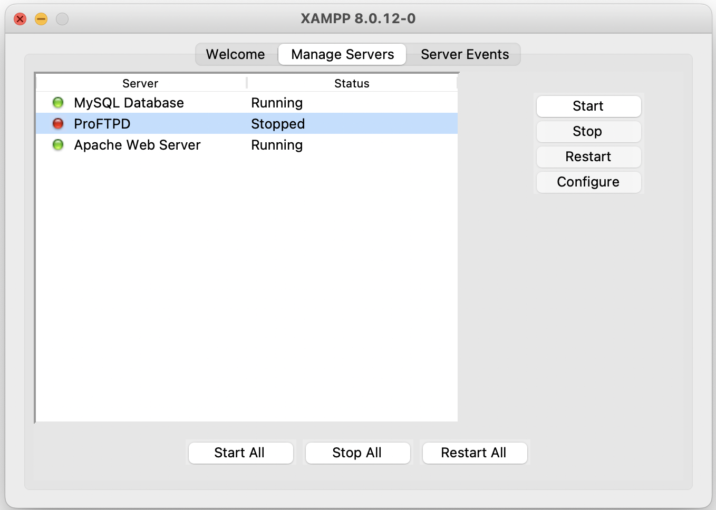
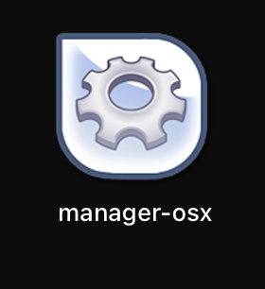
Open manager-osx to open XAMPP if you are using MacOS. Then, run MySQL DB and Apache Web Server

Slide 13

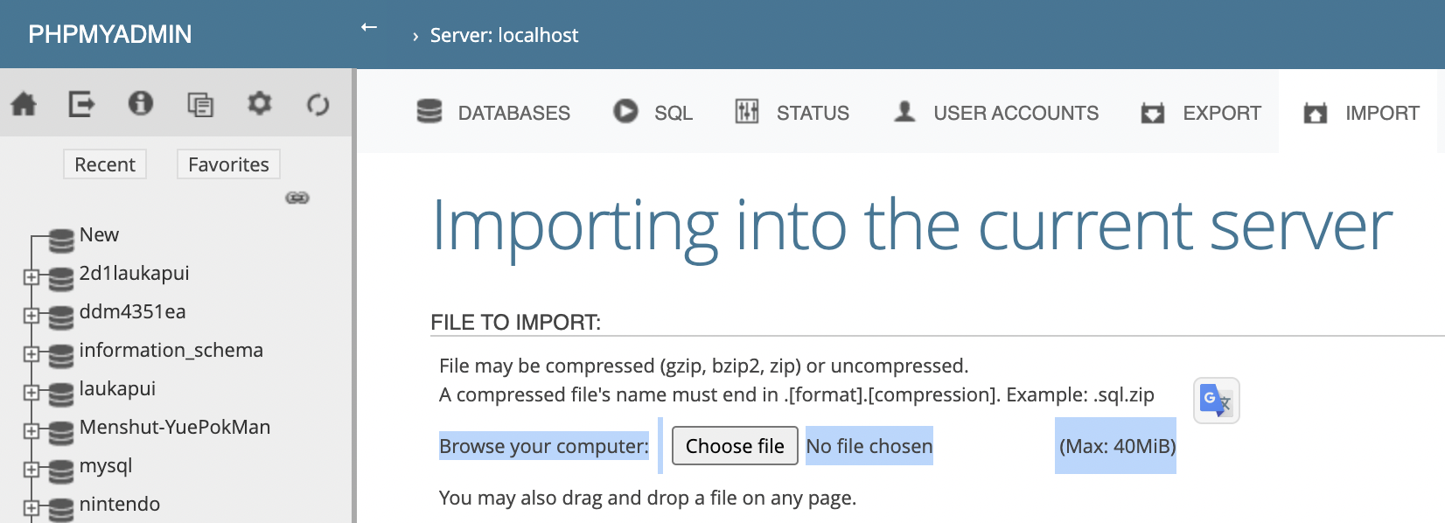
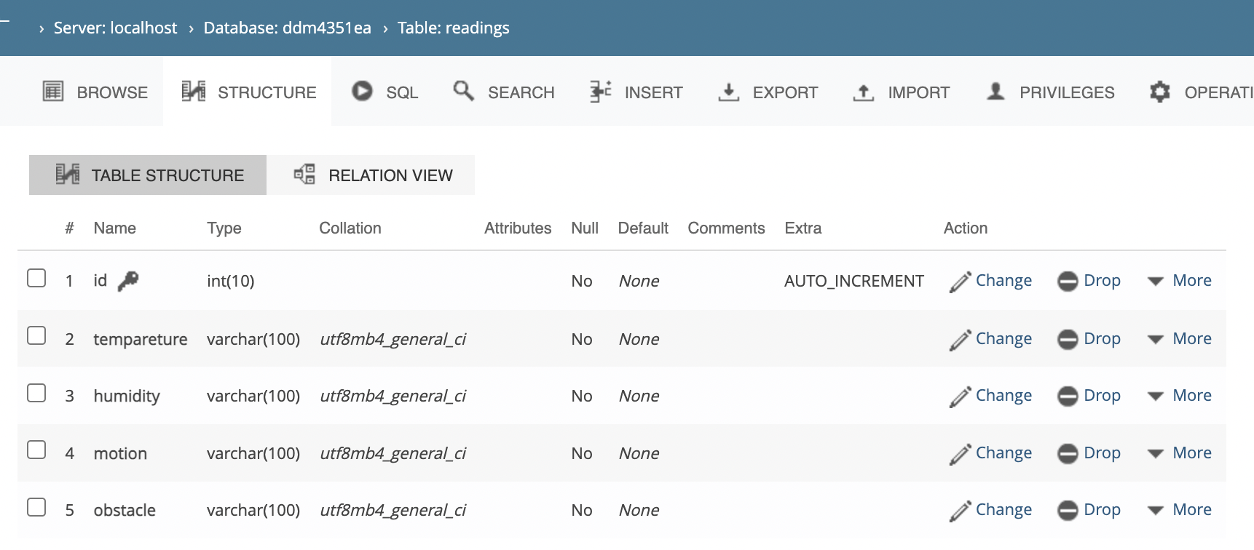
Import ddm4351.sql into your MySQL DB via PHPMYADMIN

Slide 14
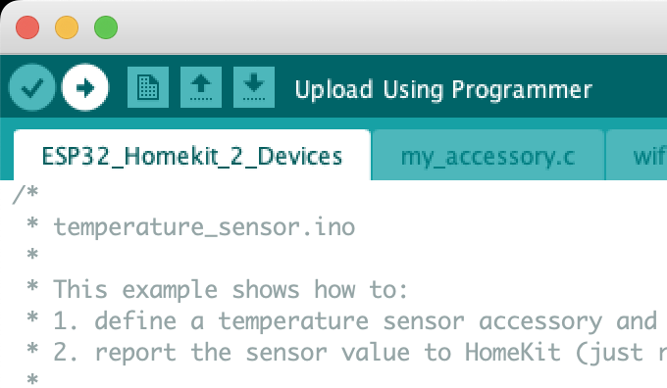
Upload your ESP32_Homekit_2_Devices.ino to the NodeMCU ESP32 board
*you may need to press the start button on the board before uploading

Slide 15
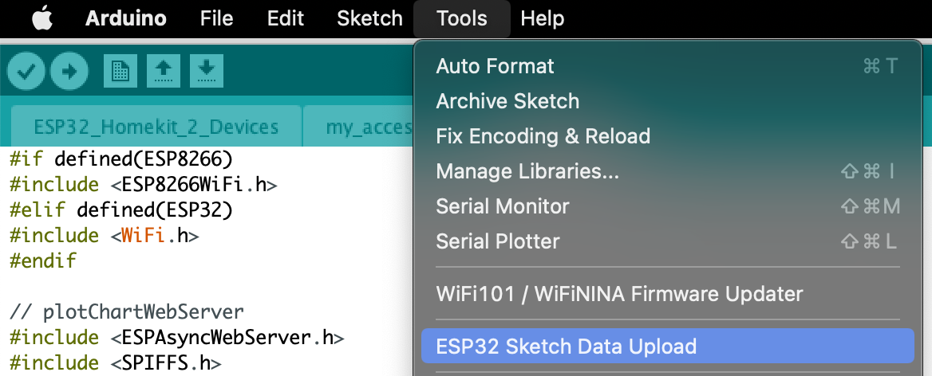
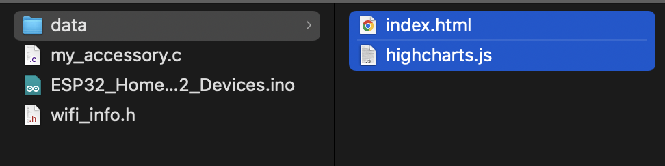
ESP32 Sketch Data Upload

Slide 16
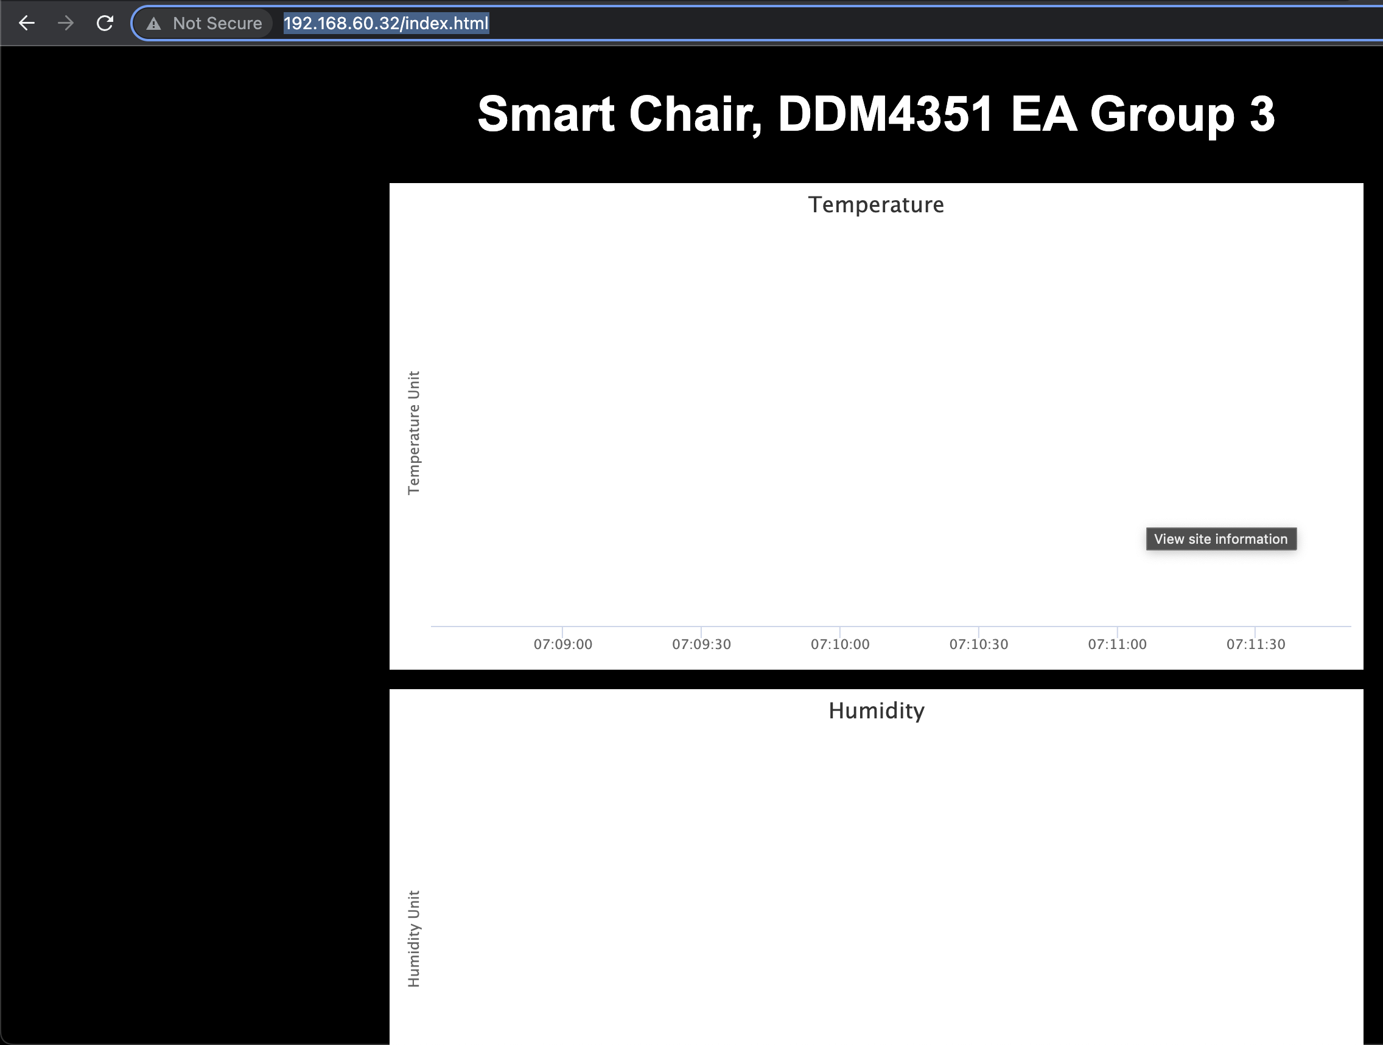
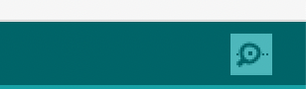
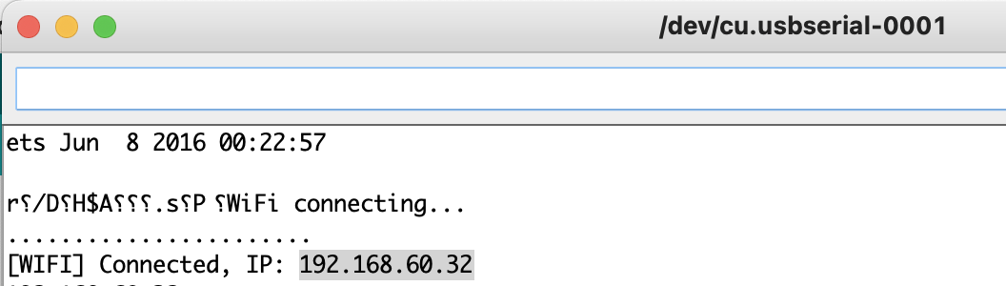
Get and enter the ESP32 TCP/IP address
Open serial monitor on Arduino

Slide 17
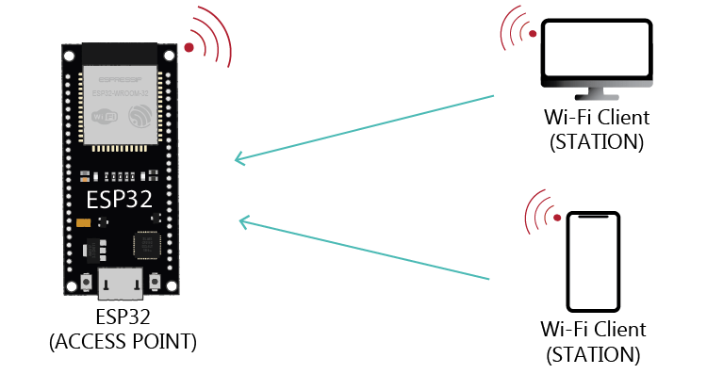
The iPhone/iPad on which the Home App is installed must be connected to the WiFi that the NodeMCU ESP32 board is connected to

Slide 18
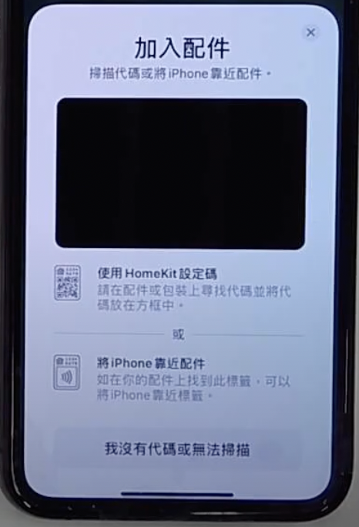
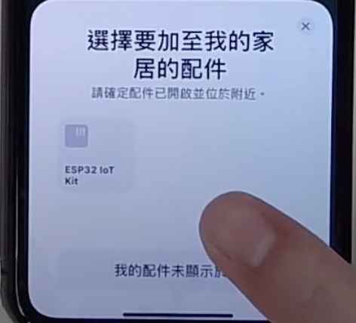
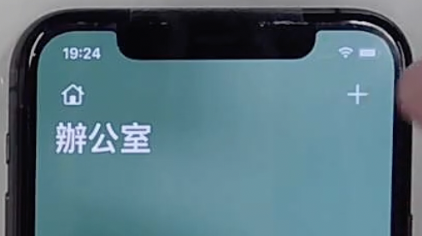
Add accessories to your Home app

Slide 19
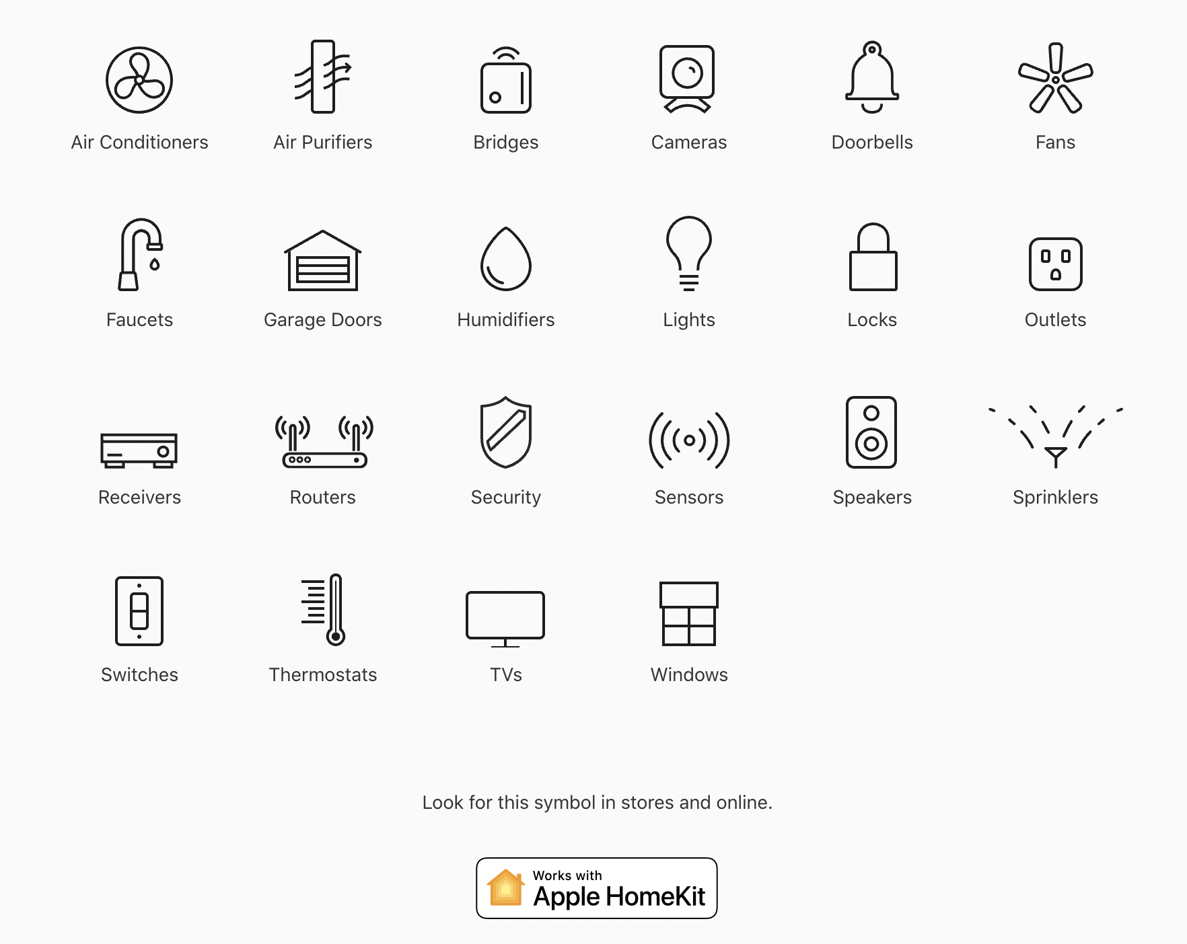
Now you can use the Home app to observe the sensor status

Slide 20
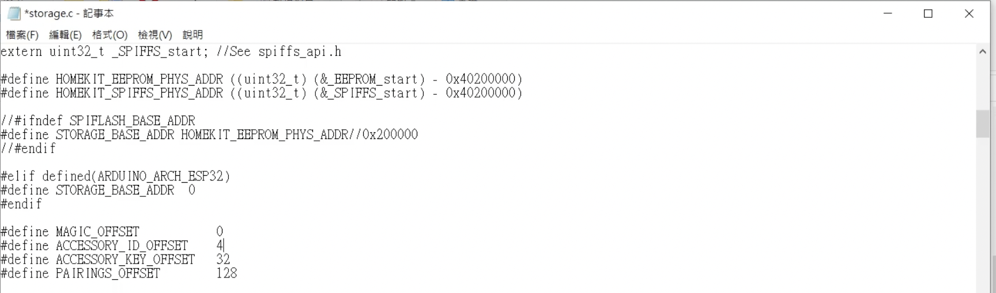
If you already have this project in your Home app, you should modify ACCESSORY_ID_OFFSET to any integer and try to reconfigure new content

Slide 21
Thank you

